Slide 1

Artificial Intelligence and Machine Learning for Space Structures
Regen Michon
Department of Mechanical Engineering Northern Arizona University
Advsior: Prof. Subhayan De
April 19, 2025
Arizona Space Grant 2025 Symposium

Slide 2
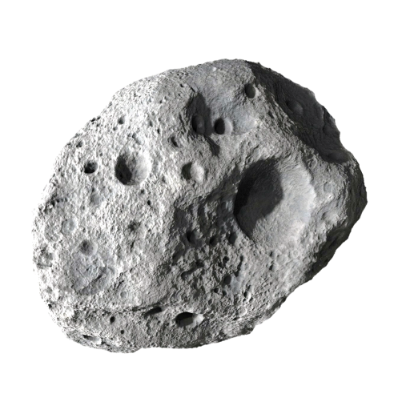
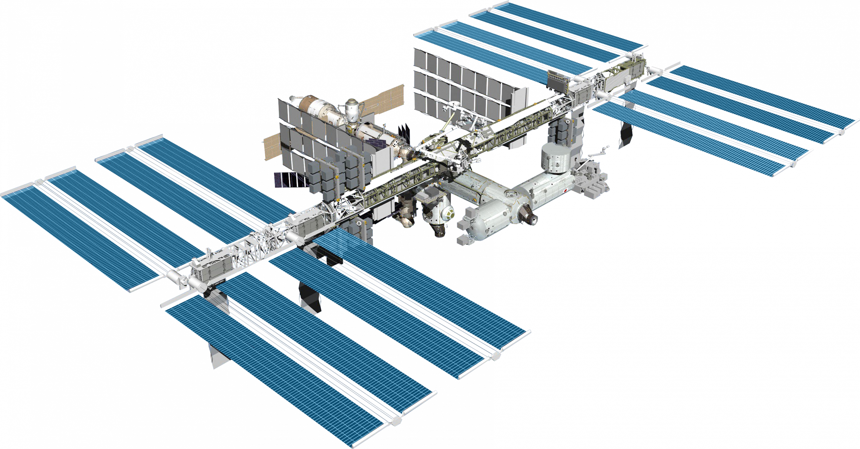
Motivation and Objectives
2
Motivation:
Space structures like the International Space Station (ISS) have numerous advanced and complex components
Uncertainty in material properties and loading
Surrogate models can be created through machine learning to model structural impact behavior in a computationally effective way.
Objectives:
Develop a finite element model of components of the International Space Station using available specifications.
Generate impact analysis training dataset
Create a machine learning assisted surrogate model.
Source: NASA

Slide 3
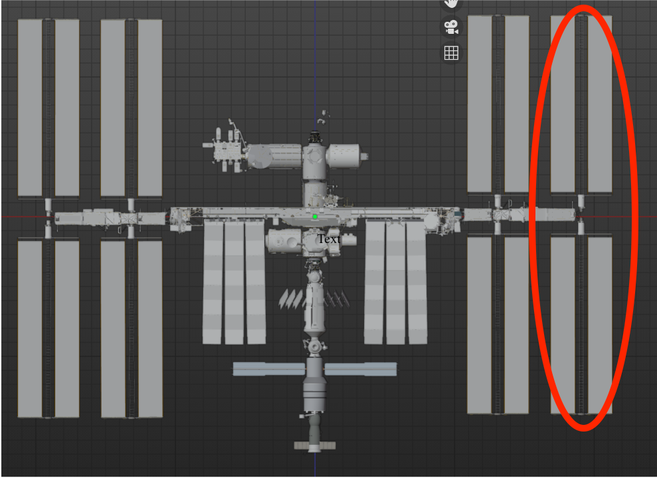
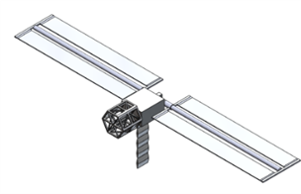
Model Setup
3
A SolidWorks model of the ISS is created using specifications from a blender model available on the NASA website.
Blender model, Source: NASA
SolidWorks model

Slide 4
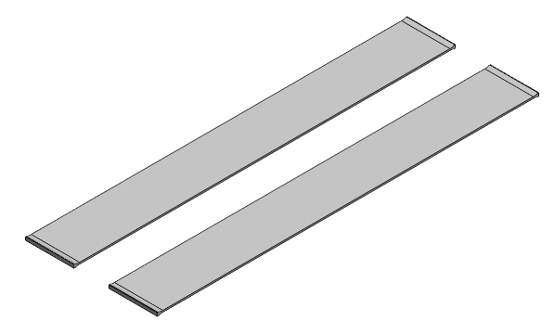
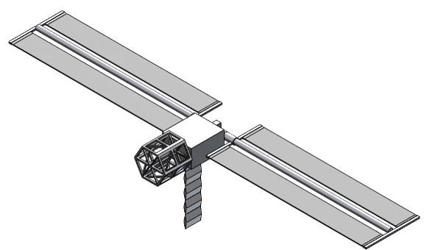
Material Assignment
4
Metal Components: 2219 Aluminum Alloy is used
Solar Panels: Gallium Arsenide is used
Gallium arsenide is the primary component in the solar panels used in space because it increases the efficiency of the panels when compared to other materials.
Solar panels contain several thin layers of different materials and electronics.
References:
"Columbus: Europe’s Laboratory on the International Space Station." ESA. Retrieved 23 August 2021.
NASA JPL Publication: Basics of Space Flight, Chapter 11. Typical Onboard Systems, Electrical Power Supply and Distribution Subsystems, "Basics of Space Flight Section II. Space Flight Projects."

Slide 5
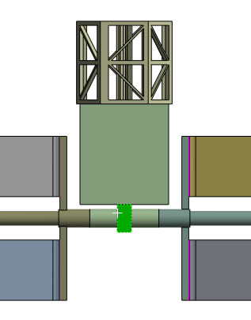
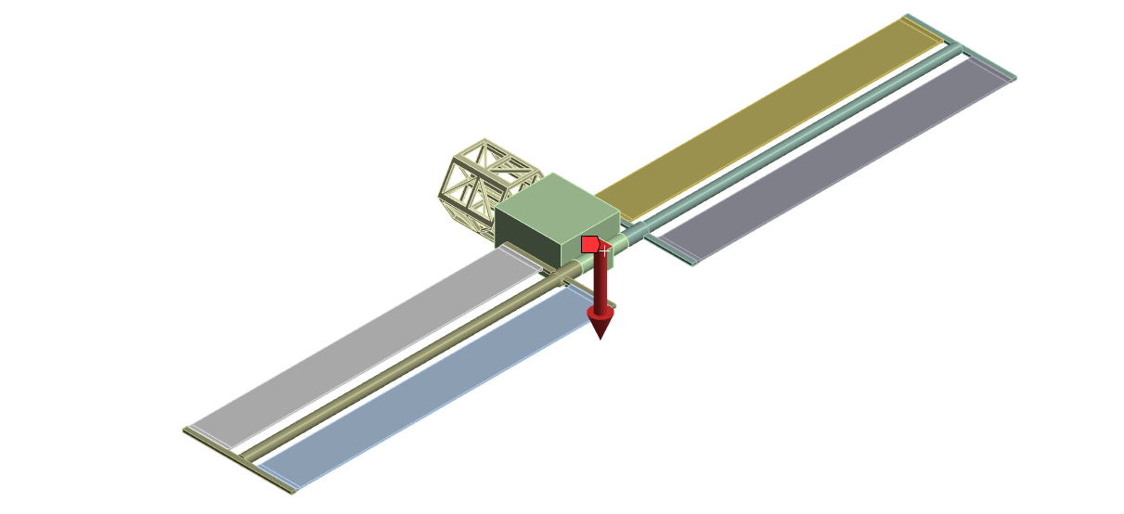
Impact Analysis
5
Using ANSYS Transient Structural Analysis a 500 kN impact for 0.2s to the ISS where the solar panels connect to the truss system is simulated

Slide 6
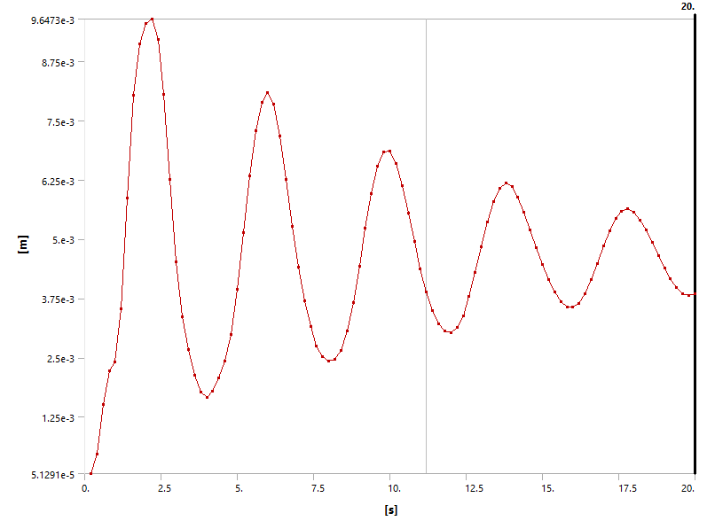
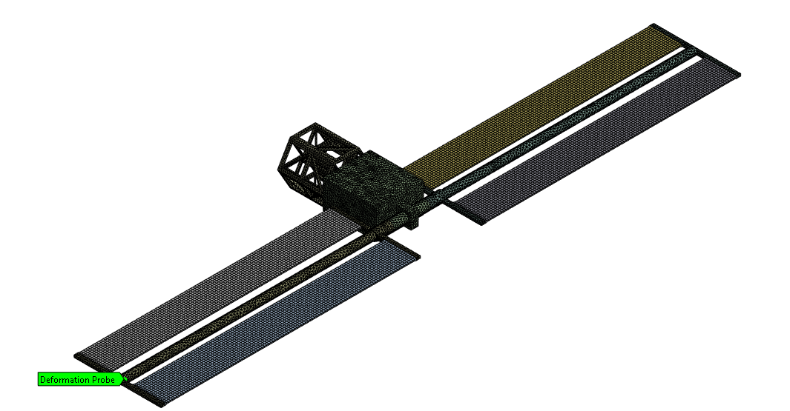
Impact Analysis
6
Deformation of furthest solar panel support is found for each realization
Deformation Probe

Slide 7
Material Uncertainty and Dataset Generation
7
To generate the training dataset, random samples are generated for the material properties from the following distributions.
 | 2219 Aluminum Alloy |  |  | Gallium | Arsenide
 | Distribution | Mean | CV | Distribution | Mean | CV
E [GPa] | lognormal | 71.3 | 0.1 | lognormal | 85.7 | 0.1
ν | lognormal | 0.34 | 0.1 | lognormal | 0.31 | 0.1
G [GPa] | lognormal | 26.1 | 0.1 | lognormal | 32.7 | 0.1

Slide 8
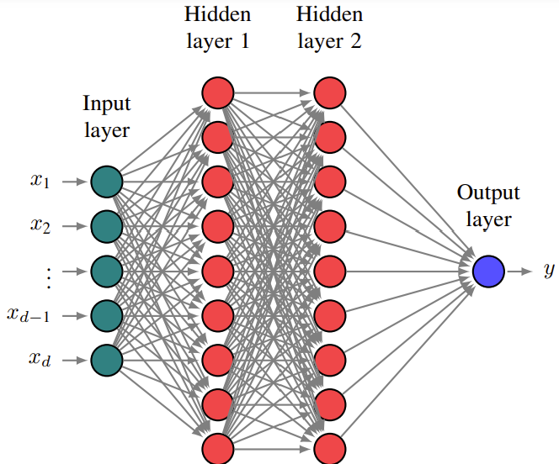
Neural Network
8
Feed Forward Neural Network :
Input Layer: Receives input data (generated data set)
Hidden Layers: Performs computations and extracts features from the input
Output Layer: Produces final output (deformation prediction)
2 hidden layers
200 neurons per layer
ELU activation
Adam Optimizer with learning rate 0.005
Trained for 20,000 epochs

Slide 9




Neural Network
9
Data setup 100x106
1 row for each realization
Columns 1-6 are realization input (material properties)
Last 100 Columns are realization output (positional data)
 | … |  |  | …

Slide 10
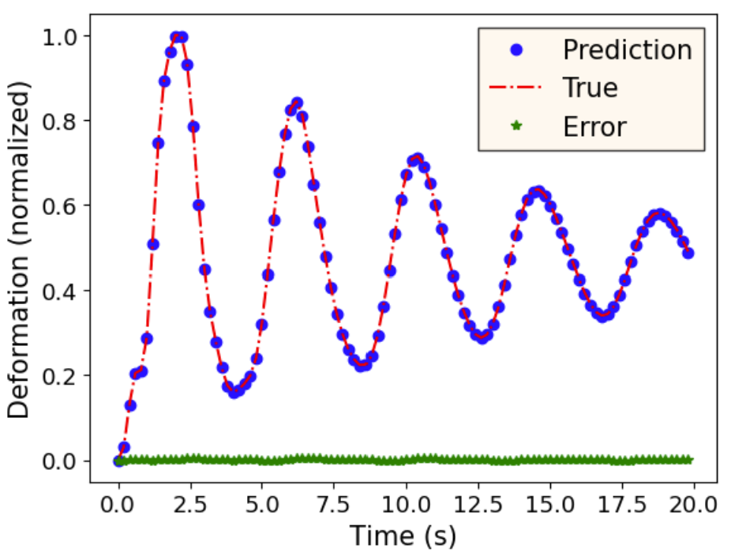
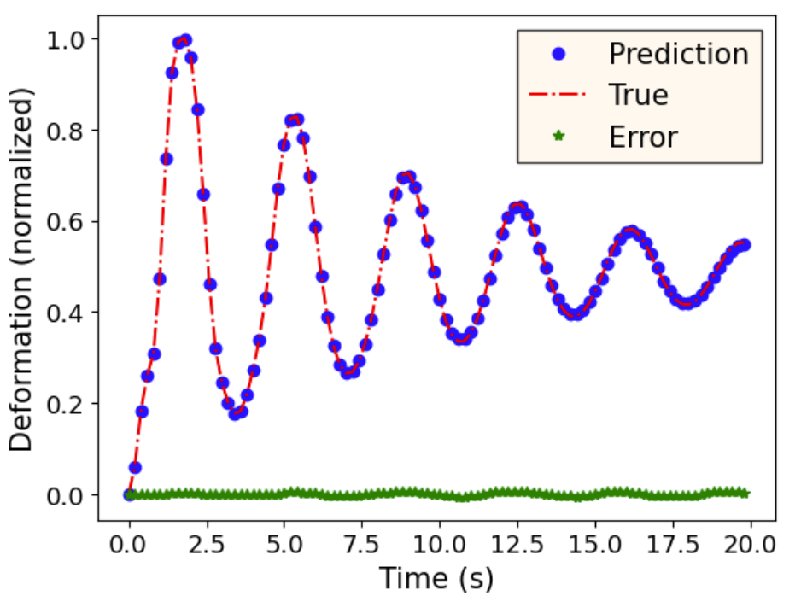

Neural Network Results
10
Relative Error

Slide 11
Conclusions and Ongoing Work
13
Conclusions:
For complex space structures, developing surrogate models can significantly reduce the computational burden for future analysis.
The effects of uncertainty in the material properties has also been incorporated.
Neural networks are effective in predicting impact analysis.
Ongoing Work:
Using training dataset with Deep Operator Network to generate another, possibly more complex surrogate model

Slide 12
THANK YOU
14

